Slide 1
Week 2 Progress Review
Bone Fracture
Detection
Dataset Analysis & XAI
FracAtlas & MURA & GRAZPEDWRI
MSc Thesis: Explainability & Reliability in Medical AI
Prof. Dr. Ayşe Berrin Yanıkoğlu & Onur Can

Slide 2


Executive Summary
Dataset Decision
Critical Mentions
Recommendation
Primary Datasets:
FracAtlas
GRAZPEDWRI
MURA
Peer-Rewieved – Published (Nature)
«Labeled» and «Bounding Boxed»
Binary only
Fractured vs. Non-fractured
2D Images
Subject Matter Experts (MDs) Established
MSc.
Binary Detection + XAI + Labeling/Attribute Generation
PhD.
MSc. Work + Severity assessment + Treatment Recommendation
Computer Aided Diagnosis (CAD)
Current Status: Ready to proceed Dataset Dive & SOTA & Novelty
✓ Domain – Sub Topic - Three high-quality public datasets identified
✓ Baselines established and ready to test
✓ Three-pillar framework (Resarch Gap) and novelty approach needs to be derived from papers!
✓ Subject Matter Experts are ready to contribute

Slide 3

FracAtlas Dataset Overview
Bangladesh Hospitals (2023) | Multi-Region Dataset
4,083
717
3,366
Total Images
Fractured
Non-fractured
Available Annotations
Classification: Study-level (fractured/non-fractured)
Localization: Bounding boxes (YOLO, PASCAL VOC)
Segmentation: Instance masks (COCO JSON, VGG JSON)
Multi-locale: hand, leg, hip, shoulder
Baseline (YOLOv8s)
Localization: Box Precision 80.7% | Recall 47.3% | mAP 56.2% @ IoU 0.5
Segmentation: Mask Precision 80.8% | Recall 47.1% | mAP 56.8% @ IoU 0.5
Low recall (47%) = Many fractures missed → Room for improvement

Slide 4
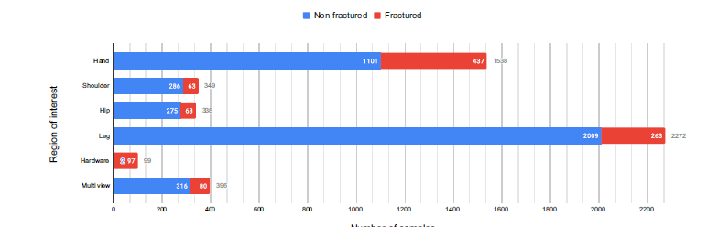
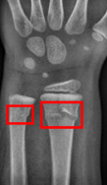
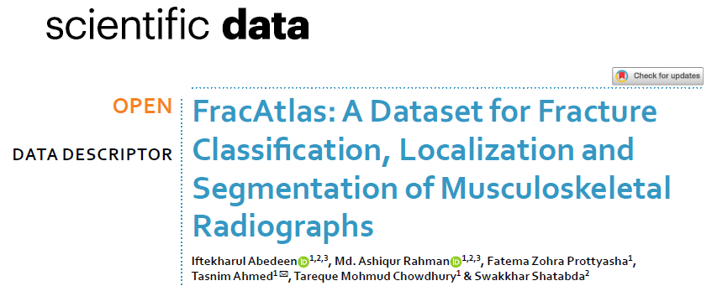
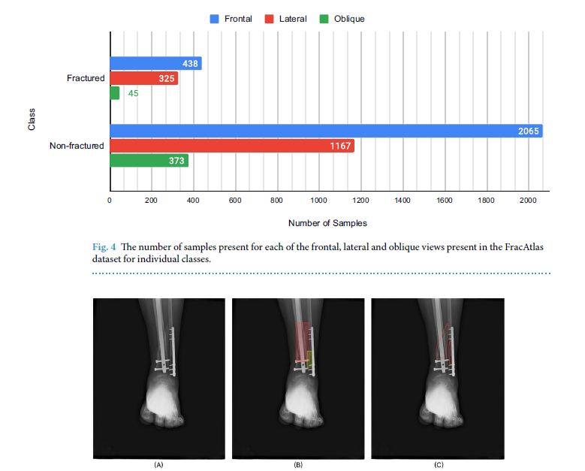
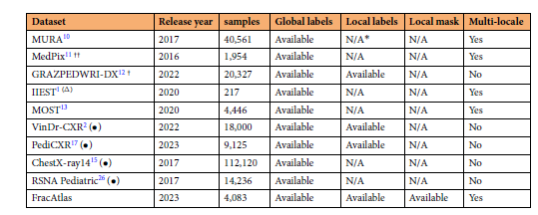
FracAtlas Dataset Overview

Slide 5

MURA Dataset Overview
Stanford MIDL 2018 | Stanford Hospital (2001-2012)
40,561
14,863
12,173
Total Images
Studies
Patients
Available Annotations
Classification: Study-level (normal/abnormal)
Radiologist Agreement: 6 radiologists on test set
Gold Standard: Majority vote validation
Localization: NOT available
Segmentation: NOT available
Baseline (DenseNet-169)
AUROC: 0.929 | Sensitivity: 81.5% | Specificity: 88.7%
Model ≈ Best radiologist on finger/wrist, lower on other regions

Slide 6
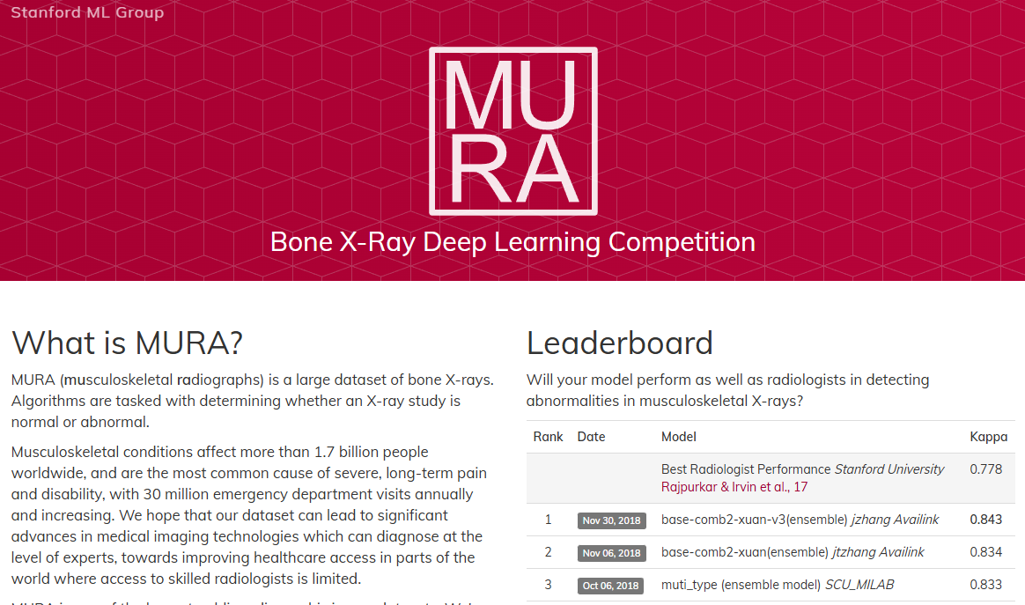
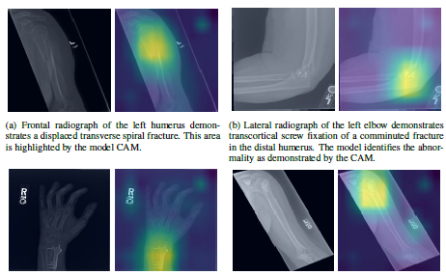
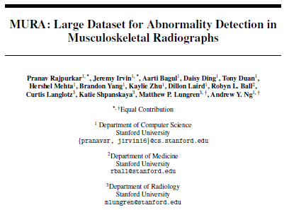
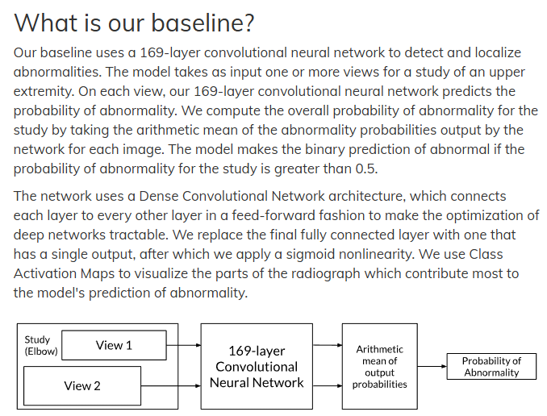
MURA Dataset Overview

Slide 7
GRAZPEDWRI-DX Dataset Overview
University Hospital Graz, Austria (2008-2018) | Pediatric Wrist Trauma
20,327
10,643
6,091
Total Images
Studies
Patients
Available Annotations
Classification: Image and object tags
Localization: Bounding boxes, lines, polygons
Pediatric Focus: Ages 0-19 years
Annotations: 67,771 objects + 74,459 image tags
Formats: Supervisely, PASCAL VOC, YOLOv5
Baseline (YOLOv8)
Fracture Detection: Precision 91.7% | Recall 88.7% | mAP@0.5 93.3%
Focus: Wrist only (PA, lateral, oblique projections)

Slide 8
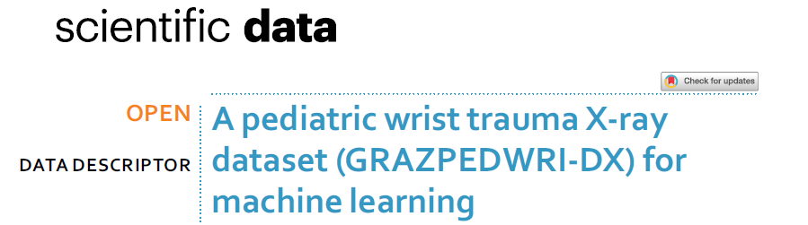
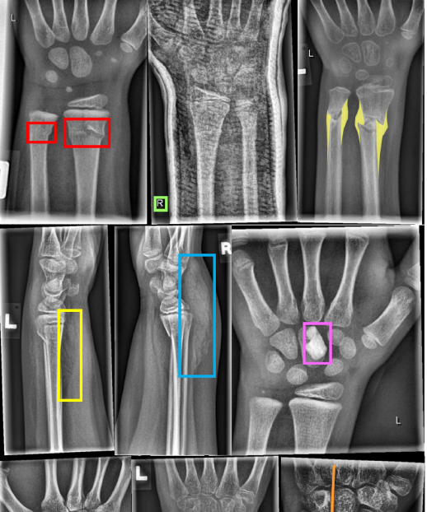
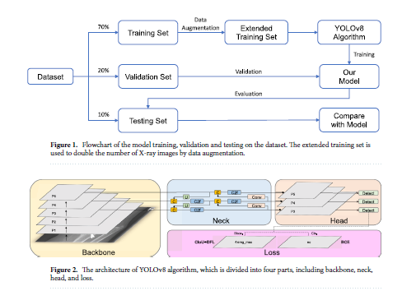
GRAZPEDWRI-DX Dataset Overview

Slide 9
Dataset Comparison
Feature | FracAtlas | MURA | GRAZPEDWRI-DX
Size | 4,083 images | 40,561 images | 20327 images
Fractured Cases | 717 images (922 instances) | ~5,818 abnormal studies | 10643 studies
Task Support | Class + Localization + Segmentation | Classification only | Image and Object Detection
Annotation Level | Image + pixel masks | Study-level only | Mask and Bounding Box
Regions | Hand, Leg, Hip, Shoulder | 7 regions (Elbow, Finger, etc.) | Wrist Only
Validation | 2 radiologists + orthopedist | 6 radiologists (test set) | Validated – Peer Reviwed
Baseline SOTA | YOLOv8 (mAP 56-63%) | DenseNet-169 (AUROC 0.929) | YOLOv8 (%90)
Code Available | ✓ Yes (GitHub) | Architecture only | Yes
Best For | Localization, Segmentation, Attributes | Large-scale validation | Localization, Segmentation,

Slide 10
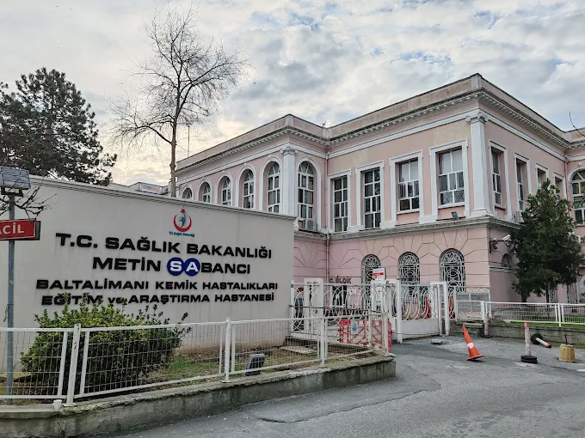
Medical Experts (MDs) are Reached Out
T.C. Metin Sabancı Baltalimanı Kemik Hastalıkları Eğitim ve Araştırma Hastanesi
Doç. Dr. Alper KÖKSAL (Ortopedi ve Travmatoloji)
Opr. Dr. Cem PEKGÜL (Ortopedi ve Travmatoloji)
Uzm. Dr. Ömer PEKGÜL (Radyoloji)
Subject Matter Experts ready to contribute/help Thesis and PhD study
Image/Body Level X-RAY attribute generation
Input Labeling (Weak or Target)
Post-Hoc Commenting
Model Instance Based Validation
And/Or any other direction thesis work needs in terms of Medical Terminology

Slide 11

Critical Issues & Decisions
Issue #1: No Severity Annotations (PhD Work)
Original MSc goal: Severity assessment (home rest / casting / surgery)
Reality: Both datasets only have binary labels (fractured vs. non-fractured)
Issue #2: Confusion Pairs Undefined
Need to identify: What are the clinically challenging distinctions?
Options: Fractured vs. Normal | vs. Degenerative | vs. Hardware
Proposed Solutions
1. Binary detection for MSc (feasible now, stays on timeline)
2. Use existing attributes (fracture masks, hardware, location)
3. Severity assessment becomes PhD extension

Slide 12
Three-Pillar Architecture
1
2
3
Attributes
Examples
Contrasts
Concept Bottleneck
Prototype Networks
Counterfactuals
• Fracture line presence
• Typical fracture patterns
• Why fractured vs. normal?
• Fracture location
• Nearest neighbors
• Attribute differences
• Hardware presence
• Visual prototypes
• Contrastive explanations
• Multi-fracture count
• Similar training cases
UNIQUE CONTRIBUTION: First integration of all three pillars for bone fracture detection

Slide 13



Proposed Research Direction
MSc Thesis Focus
PhD Extension
Task:
Binary fracture detection
Dataset:
FracAtlas (primary) + MURA (validation)
Method:
Three-pillar explainability
Task:
Severity assessment
Requires:
500-1000 annotated images
Output:
Treatment planning support
Clinical Value & Unique Contribution
Not just 'Is there a fracture?'
'WHY is it fractured?' Supporting evidence for : attributes, similar cases, contrasts
Foundation for PhD: Detection → Severity → Treatment planning

Slide 14




Updated Timeline
Week 1-2
Domain selection, dataset ID, lit review
Week 3-4
Literature Search, Dataset deep dive, SOTA investigation, model prototype
Week 5
Attribute definition, decision on direction
Week 5-8
Implement 3-pillar system
Week 9-10
Experiments, evaluation, ablations
Week 11-12
Writing, polishing, defense prep

Slide 15
Key Decision Points
1
Binary detection vs. Severity assessment?
Binary: Feasible now, on timeline | Severity: Requires 500-1000 annotations
→ Binary for MSc
2
Radiologist access for annotations/validation?
Needed for: Severity grades OR prototype validation | Timeline impact if unavailable
→ Clarify availability
3
Which confusion pair priority?
Fractured vs. Normal (standard) | Fractured vs. Degenerative (novel)
→ Start with standard

Slide 16
Next Steps
This Week (Week 3)
✓ Download & explore datasets (Mon-Tue)
✓ Reproduce baseline results (Wed)
✓ Search SOTA papers 2023-2025 (Thu)
✓ Prepare decision report (Fri)
Next Week (Week 4)
Finalize direction → Define attributes → Begin Pillar 1 implementation
Ready to code by Week 3 once direction confirmed

